Slide 1


Student TASK Reminder and Wellness website
Balancing Academic Work and Mental Health

Slide 2

Problem Statement
- Mental Load: Overwhelmed by assignments, exams, and extracurriculars
- Class Reminder Fatigue: Exhaustion from continuous reminders
- Poor Planning: Difficulty organizing study schedules, leading to procrastination and missed deadlines

Slide 3

Personas: Understanding Our Users
Persona 1: Alex - Age: 20 - Academic Focus: B.ED - Goals: Manage assignments and deadlines efficiently, avoid last-minute cramming
- Pain Points: Frequently forgets assignments and tasks, experiences stress due to lack of time management
- Persona 2: Karabo - Age: 25 - Academic Focus: BA - Goals: Balance academic responsibilities with wellness, maintain mental and physical health
- Pain Points: Often forgets to take breaks, suffers from burnout, finds it hard to manage long research deadlines

Slide 4
The App's Core Functionalities
Task Manager
- Push Notification Reminders
- Wellness Check-ins
- Study Planner
- Progress Tracking

Slide 5

How Users Interact with the App
- Instructing (Task Manager)
- Conversing (Wellness Check-ins)
- Manipulating (Study Planner)
- Observing (Progress Tracking)

Slide 6
A Digital Planner
Organizes academic tasks and wellness activities in one space
- Provides a structured yet flexible overview of the academic journey

Slide 7
Guiding the Design Process
- Visibility
- Affordance
- Feedback
- Consistency
- Constraints

Slide 8
Assessing the App's Effectiveness
- Usability Goals: Task Completion Efficiency, Learnability
- UX Goal: User Engagement
- Evaluation Method: Think-Aloud Testing

Slide 9

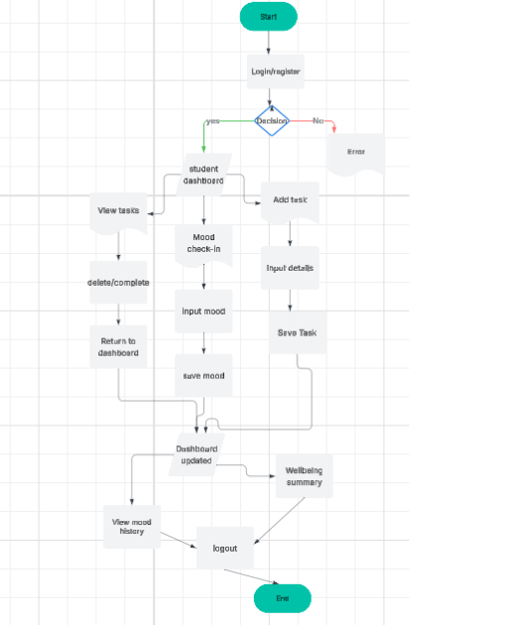



conceptual model using a labeled diagram

Slide 10
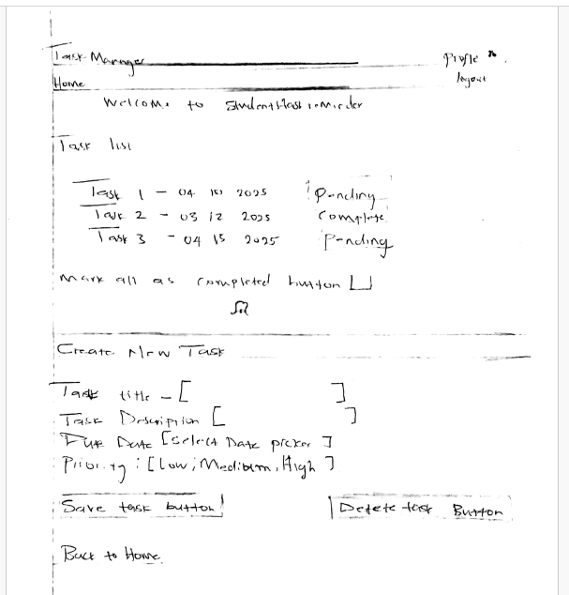
Sketched key screens

Slide 11
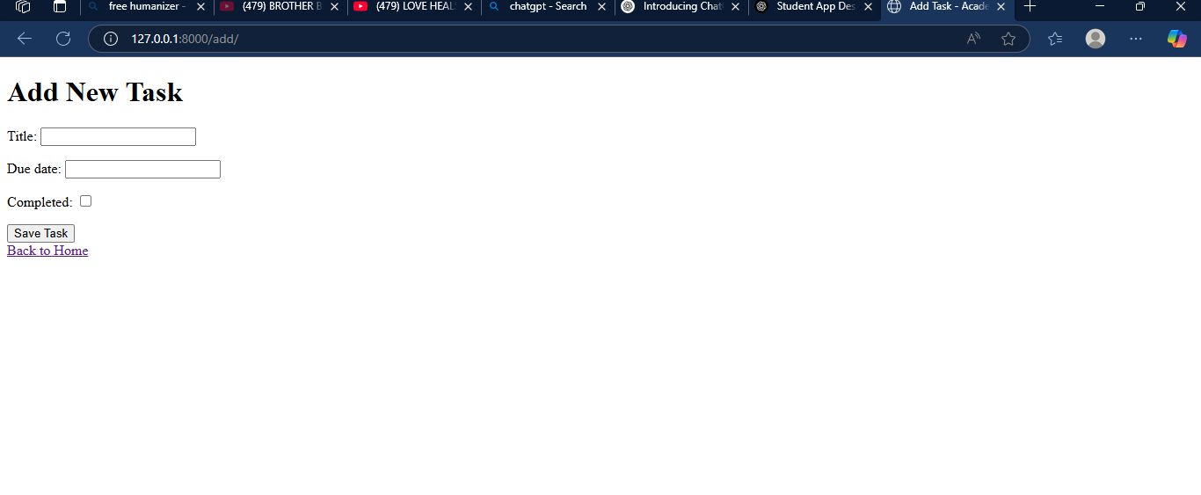
Website display :task form

Slide 12
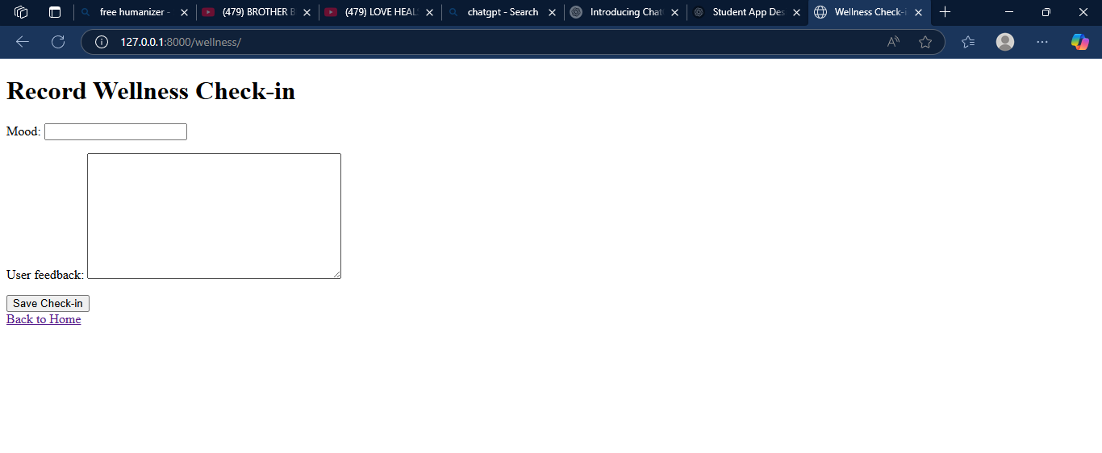
Website display : wellness check form

Slide 13

Conclusion
Student Task and Wellness website aims to help students manage academics and mental well-being through a user-centered design approach, prioritizing features that promote academic success and wellness.

